Slide 1
Air Quality Monitor
By,
S. Samaya Naveen

Slide 2
Introduction
Main objective-is to make an IOT based Air Pollution Monitoring System.
It is used to monitor the quality of air around us and check the amount of harmful gases present in the air.
It helps us in knowing he quality of air especially in industrial and other prime areas.

Slide 3
Principle
Here sensor is used to detect the presence of harmful gases present in the air of an industrial area .
The sensor shows the air quality in terms of parts per million(PPM).
If the air quality goes down beyond a certain value an alarm is triggered .

Slide 4
Components Required
MQ135 Gas sensor
Arduino Uno
Wi-Fi module ESP8266
16x2 LCD
Buzzer

Slide 5
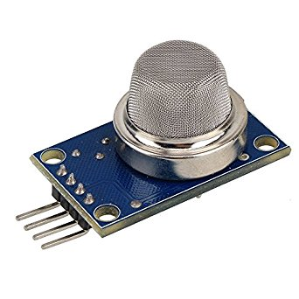
MQ135
Previously MQ6 and MQ2 sensors to detect but this time we use a MQ135 sensor which is the best choice.
It is used to measure the concentration of combustible gases in the air.
It can detect the gases like ammonia nitrogen, oxygen, CO2,smoke etc..

Slide 6
The operating voltage of the gas sensor ranges from 2.5v to 5v.
The resistance of the sensor decreases with the presence of combustible gases and remains constant at clean air.
The output of the sensor is in voltage thus when on presence of harmful gases voltage decrease and voltage increases on clean air.

Slide 7
Wi-Fi Module
The ESP8266 Wi-Fi Module is used to connect with any available internet hotspot and transfer sensor data to an internet platform.
IT is a self contained SOC with integrated TCP/IP protocol stack that can give any microcontroller access to a Wi-Fi network.

Slide 8
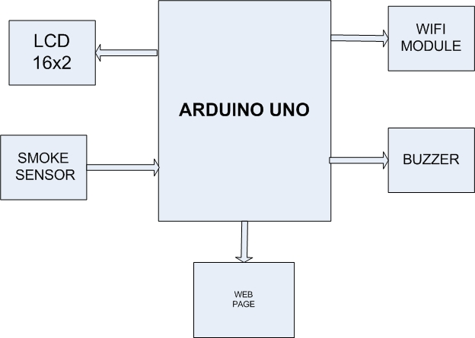
Bock Diagram

Slide 9
Working
The MQ135 sensor can sense NH3, NOx, smoke, Co2 and some other gases.
When it is connected to Arduino it will sense the gases and convert the analog output into digital value using the in-built ADC channel .
The value obtained is proportional to the concentration of the gases in PPM.

Slide 10
The safe level of air quality is 350 PPM and it should not exceed 1000 PPM.
First the output air quality level is displayed in the on the LCD screen and if it is less than 1000 PPM it displays “Fresh Air”.
Whenever the value increases 1000 PPM the buzzer will start beeping and the LCD will display “Poor Air”.
Using the Wi-Fi module whenever the air quality is poor it send an alert message to the “Central Pollution Control Board” and to the industrial members.

Slide 11
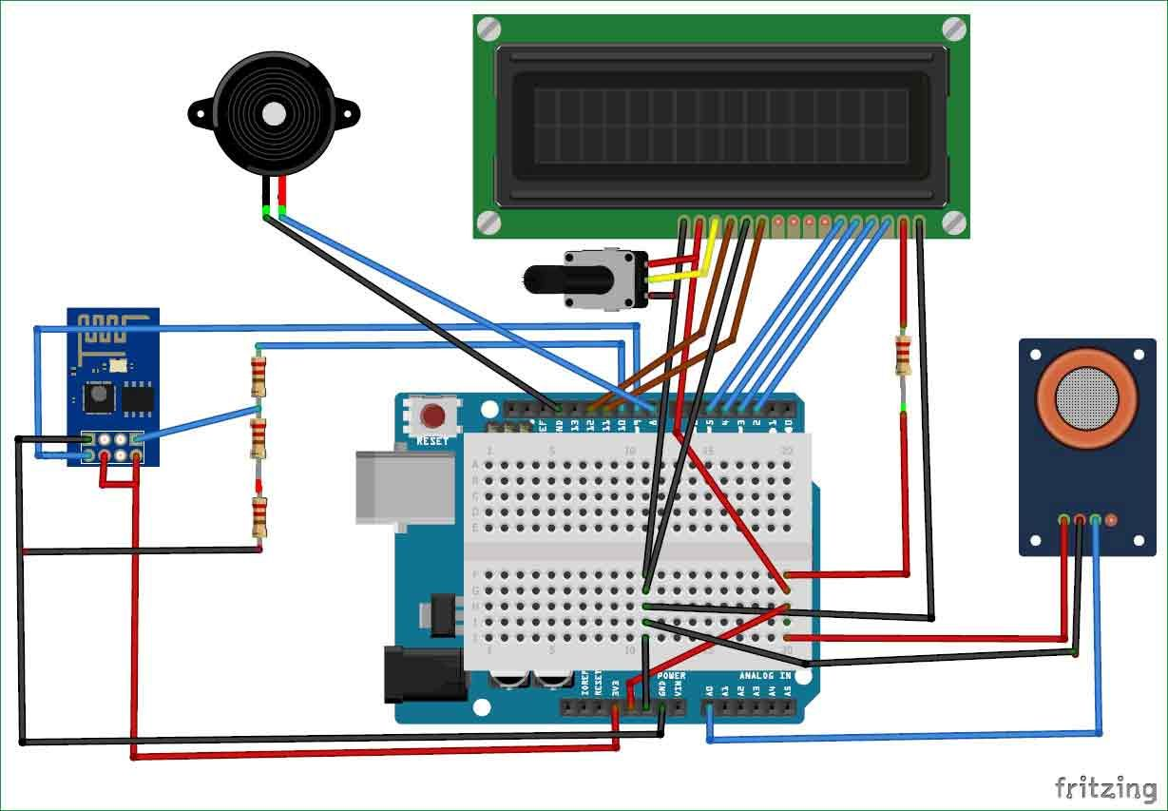
Circuit Diagram

Slide 12
Applications
The Air Quality Monitoring system can be mainly engaged in industrial areas to monitor the quality of air in that locality .
To send warning signals to industrial members and pollution control board whenever it exceeds 1000 PPM.
This can also be used in vehicles to monitor the smoke released from it and to send information to owner when its emission rate is high.

Slide 13


